Slide 1
301, Nov 12, Class 25
Qualitative Research
Field Research

Slide 2
Quasi-Experimental Research Methods
Mix of experimental and non-experimental methods
  Requires at least one controlled independent variable
Qualitative Research
  Systematic observation of relationships in society
Field Research
  Experimentation in the real world, outside of laboratory control
Intervention (Translational) Research
  Bringing basic science results to application
  Verifying effectiveness

Slide 3
Qualitative Research
“If love were to guide us: The story of Fred Hampton High School’s quest for building bridges of belonging for black students.” Randolph, D. (2024)
Abstract: This action research study investigates how Black students experience and make sense of belonging at Fred Hampton High School, a suburban Illinois school known for its racial equity initiatives. Drawing on Critical Race Theory and using Safir and Dugan’s (2021) street data framework, the study centers the voices of Black students through focus group interviews to understand the systemic, interpersonal, and cultural barriers they face. Key themes include racial microaggressions, symbolic leadership, inequitable disciplinary practices, and lack of authentic representation. Despite the school’s reputation for diversity and strong racial equity work, the findings demonstrate the factors that explain why Black students report the lowest sense of belonging among all racial groups at Fred Hampton High School. Contributing factors include performative equity practices and administrative inaction. This study highlights students’ critiques of Hampton’s school culture and offers practical, student-informed recommendations for fostering an inclusive racial climate. By using storytelling as both a methodological and theoretical tool, this research aims to disrupt deficit narratives, promote student agency, and reimagine what is possible when school transformation is guided by love.

Slide 4
Interviews
Methods borrowed from Sociology, Anthropology
Collect stories of personal experience
  Anecdotes are not data but they are illustrative
  Insight into cross-cultural differences

Slide 5
Quantifying Qualitative data
Structured interviews
  Protocol for interview procedures
Coding systems
  Count occurrences of words, ideas
  Calculated relationship among measures
Verbal protocol analysis
  Talking out loud during problem solving

Slide 6
Qualitative research is often used in a research program as a first or preliminary study before research with experimental methods and manipulated variables. Why is this?
Why might we use a qualitative research technique to study parent-child interactions and aggressive behavior in preschoolers? Outline what such a study might look like.
In a diary study of conflict resolution in relationships, the research protocol could involve daily documentation of any conflict experiences and how they were or were not resolved. What kinds of events might be coded for and counted in a study of this type?

Slide 7
Wason Card Task
A
D
4
7
Hypothesis: If a card has a vowel on one side, then it has an even number on the other side.
Which cards do you turn over?

Slide 8
The Bar Bouncer task
Soda
Beer
16
22
Hypothesis: If a person is drinking beer, they must be 21 years or older…
Which cards do you turn over?

Slide 9
Field Research
Can be qualitative
  Interviews in context
  Structured observation
Manipulating contextual variables
  Making the research experimental

Slide 10
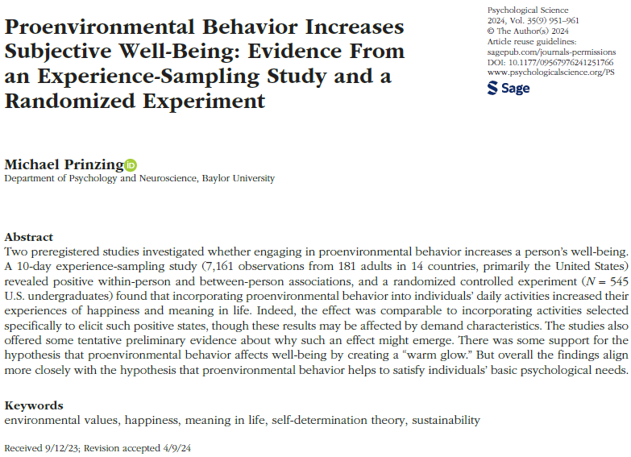

Slide 11
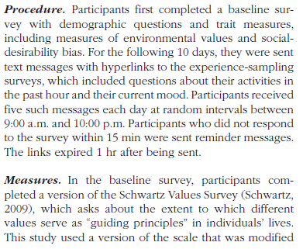
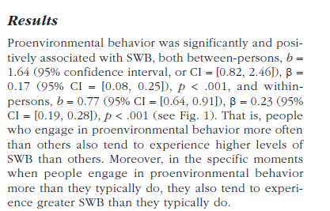
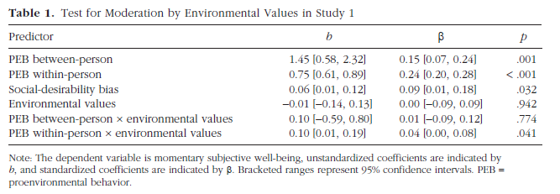
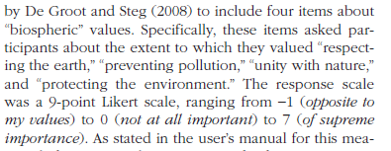


Slide 12
Experiment 1 involves several measures collected at baseline and an experience sampling approach done by text messages over the next 10 days. Which specific element of the Experiment 1 procedure would involve using qualitative methods to analyze?

Slide 13
Experience Sampling
Research method where participants are repeatedly asked to report on their thoughts, feelings, and behaviors in real-time throughout their daily lives, providing a snapshot of their experiences as they occur in their natural environment, usually through prompts on a mobile device or similar technology (text or reminder app).
What extraneous variables should we consider with this kind of real-world based data collection?

Slide 14
In Experiment 2, what variable was manipulated? How many levels of the variable were used and what were they?
What aspect of Experiment 2 was analyzed with qualitative methods?

Slide 15
Exp 2
Participants in the control condition were given a neutral task: “Tomorrow, we would like you to keep track of your activities. You do not need to remember who you were with or how you were feeling during that time. Instead, just try to remember factual information about what you are doing. Do not alter your routine. Simply keep track of what you do.”
Participants in the proenvironmental behavior condition received the following instructions: “In our daily lives, we all make choices that affect the environment. Tomorrow, your task is to do three good things for the planet, all three in one day.” We gave a list of example behaviors, including some that would be easy for young adults to implement on any particular day (e.g., “Walk, bike, or take public transportation instead of driving” or “Find a new recipe that uses vegetarian or locally produced ingredients”)…
Participants in the fun condition received the following instructions: “In our daily lives, we all perform acts of kindness for others, but we often neglect to do nice things for ourselves. Tomorrow, your task is to do three good things for yourself, all three in one day.” We again gave examples (e.g., “Relax in a bath or hot tub” and “Spend some time on a hobby”) and told participants that, although they could do whatever they liked, they should choose activities that they would not typically do for themselves.
Two days later, participants returned for follow-up. They first completed SWB measures and afterward described in their own words what they had done on the previous day.

Slide 16
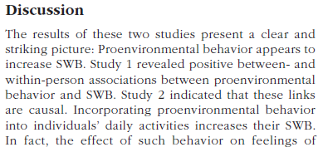
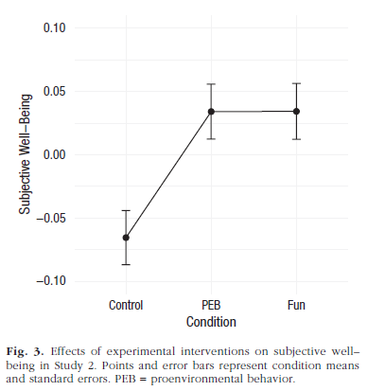


Slide 17
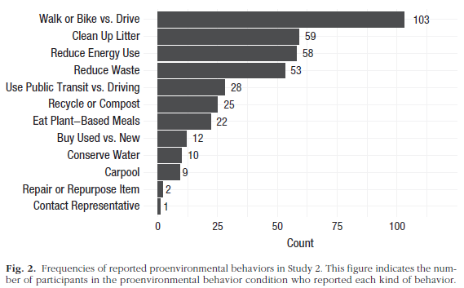
Open-ended questions
Two days later, participants returned for follow-up. They first completed SWB measures and afterward described in their own words what they had done on the previous day.
We content-coded the responses to the open-ended question in order to catalog the kinds of proenvironmental behaviors that participants chose to engage in.
  N = 545
  37 excluded for lack of engagement

Slide 18
For Fri 11/14
Chapter 17, Applied Research
  Questions on Canvas
Keep us posted on your Final Project proposal process
  We want to approve these (when ready) so you can start data collection

